Slide 1
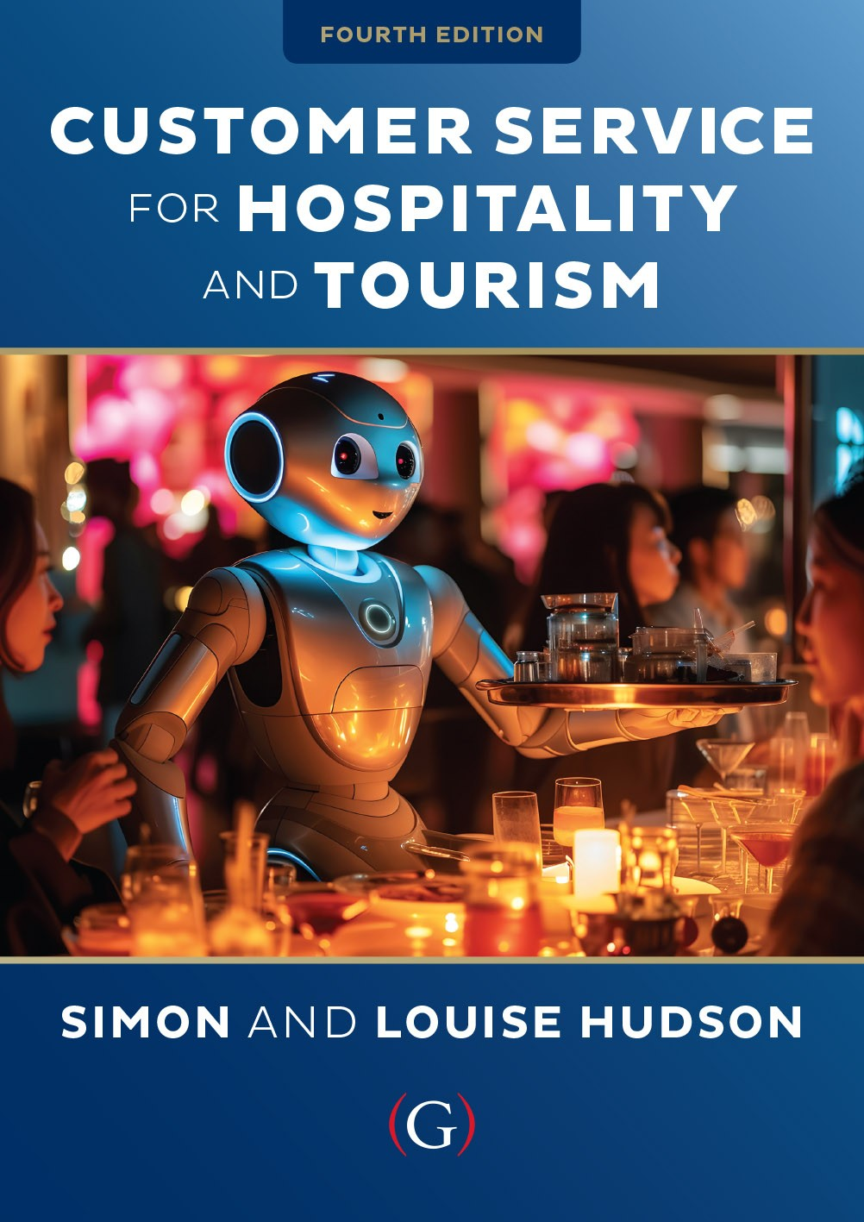
Chapter 6
The importance of market research

Slide 2

Topics covered
  An introduction tourism and hospitality research
  The GAPS model of service quality
  Different ways of measuring service quality
  Common research errors
  Effective use of market research in decision making

Slide 3
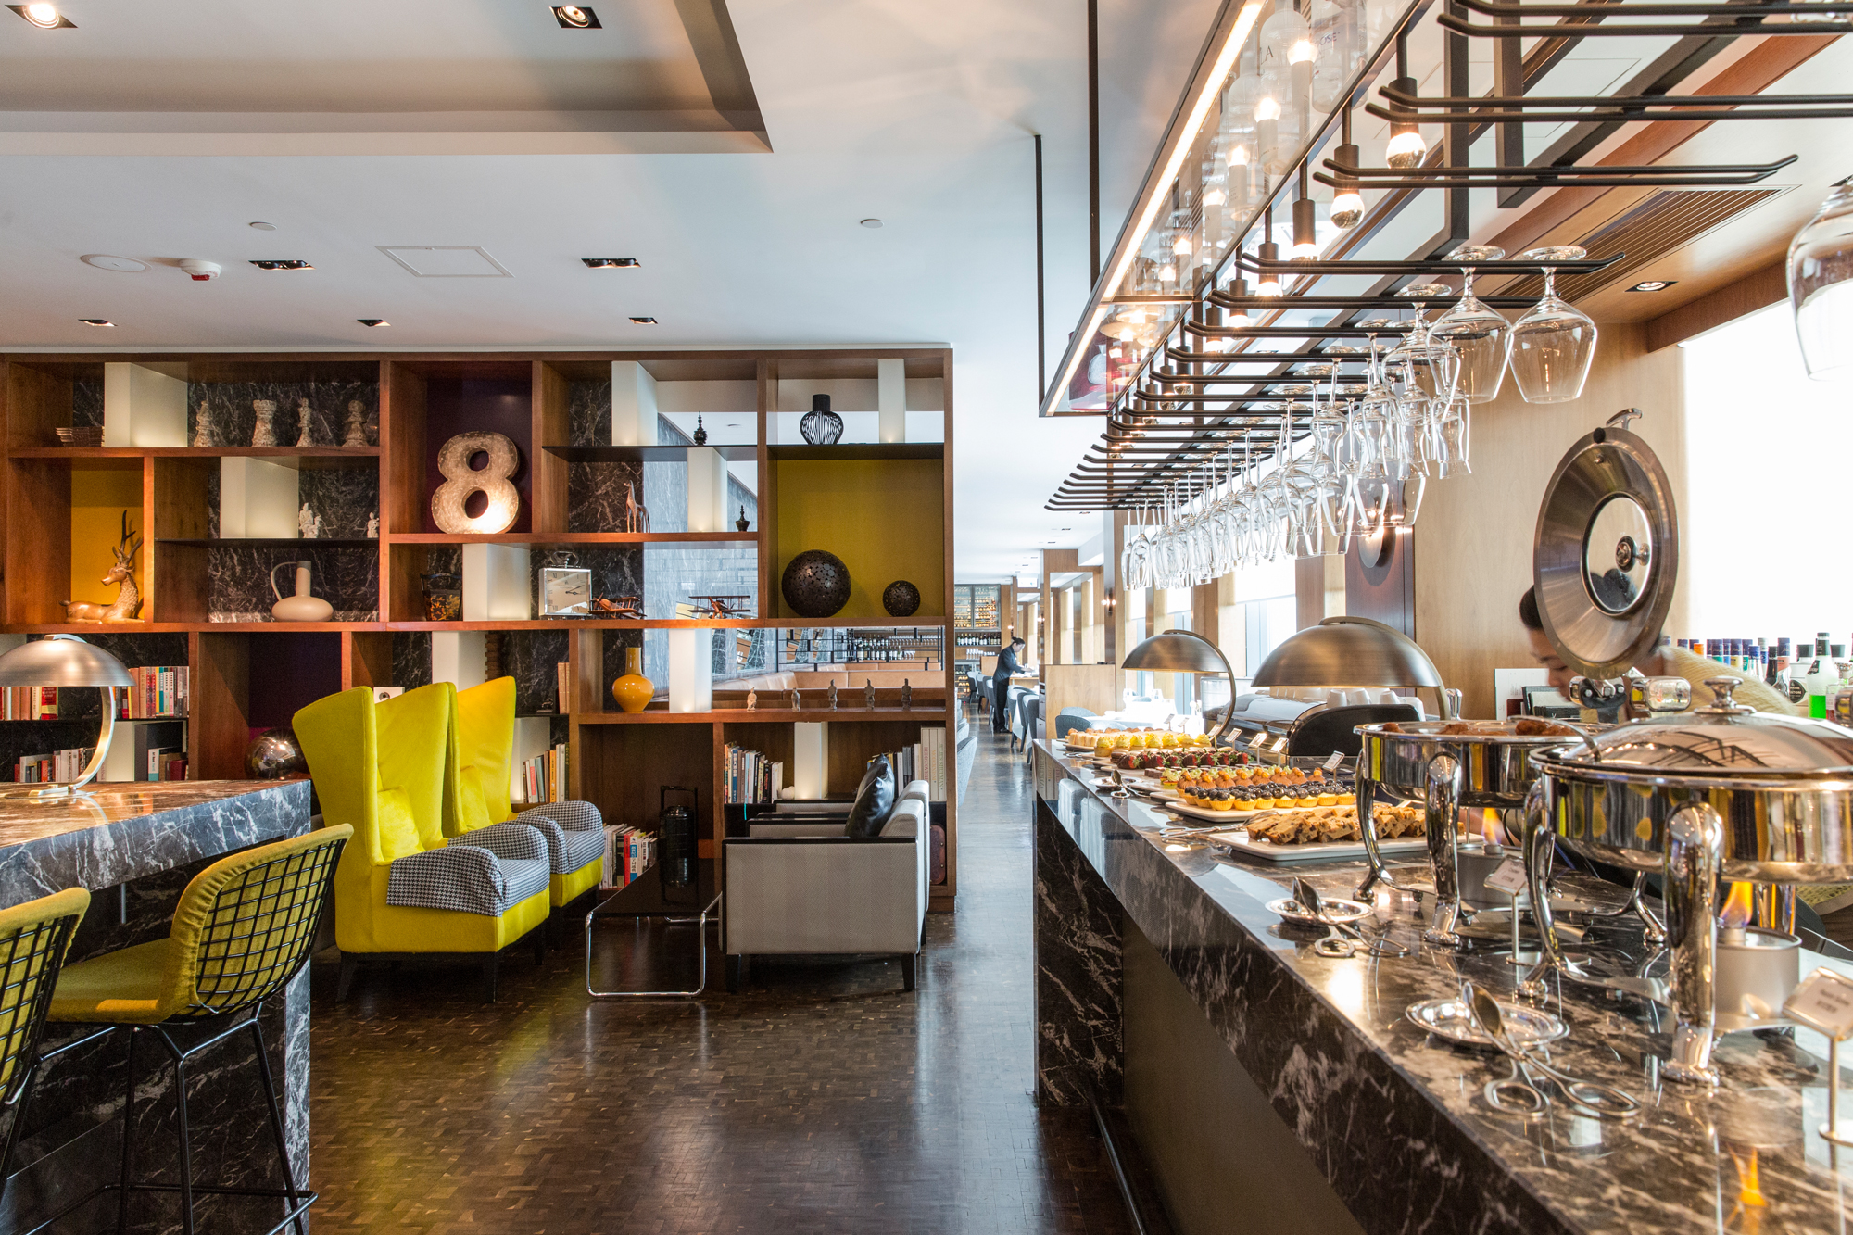
‘At Your Service’ Spotlight:
Developing hospitality leaders of the future at the Hotel Ikon, Hong Kong
Hotel ICON is a unique teaching and research hotel in Hong Kong that offers a fully integrated teaching and learning approach to education.
“We spend a lot of our time around innovation, creativity, looking at new technology and service design”
Training program called We Love to Care incorporates three fundamental areas; Operational Excellence, Aesthetic Excellence & Emotional Excellence
Research is taken seriously at Hotel ICON – e.g. some guest rooms are used to try new innovations

Slide 4
Introduction to research in tourism and hospitality
Market research is often ignored
  Considered costly and time-consuming
  Undertaken only for major developments
  Contributions to day-to-day operations overlooked
  Organizations often ignore existing, accessible information
  Study results often ignored or not fully considered
Applied research in tourism & hospitality can be grouped into eight categories

Slide 5
Applied research in tourism & hospitality
Table 6.1

Slide 6
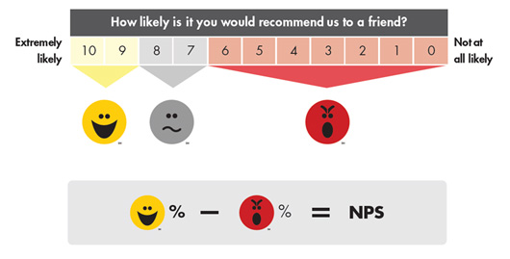
Consumer research
Is of particular interest to the study of customer service
Important for measuring customer loyalty
One way of measuring this loyalty is the Net Promoter Score

Slide 7
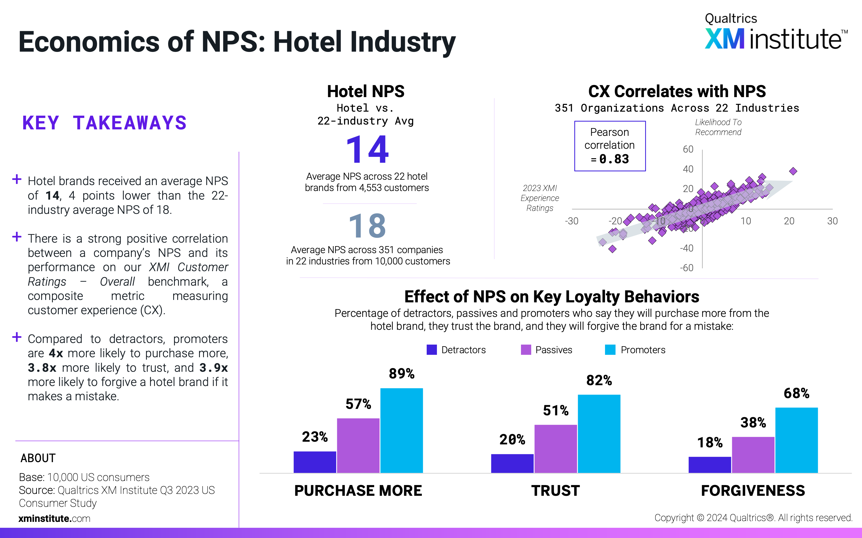

Slide 8
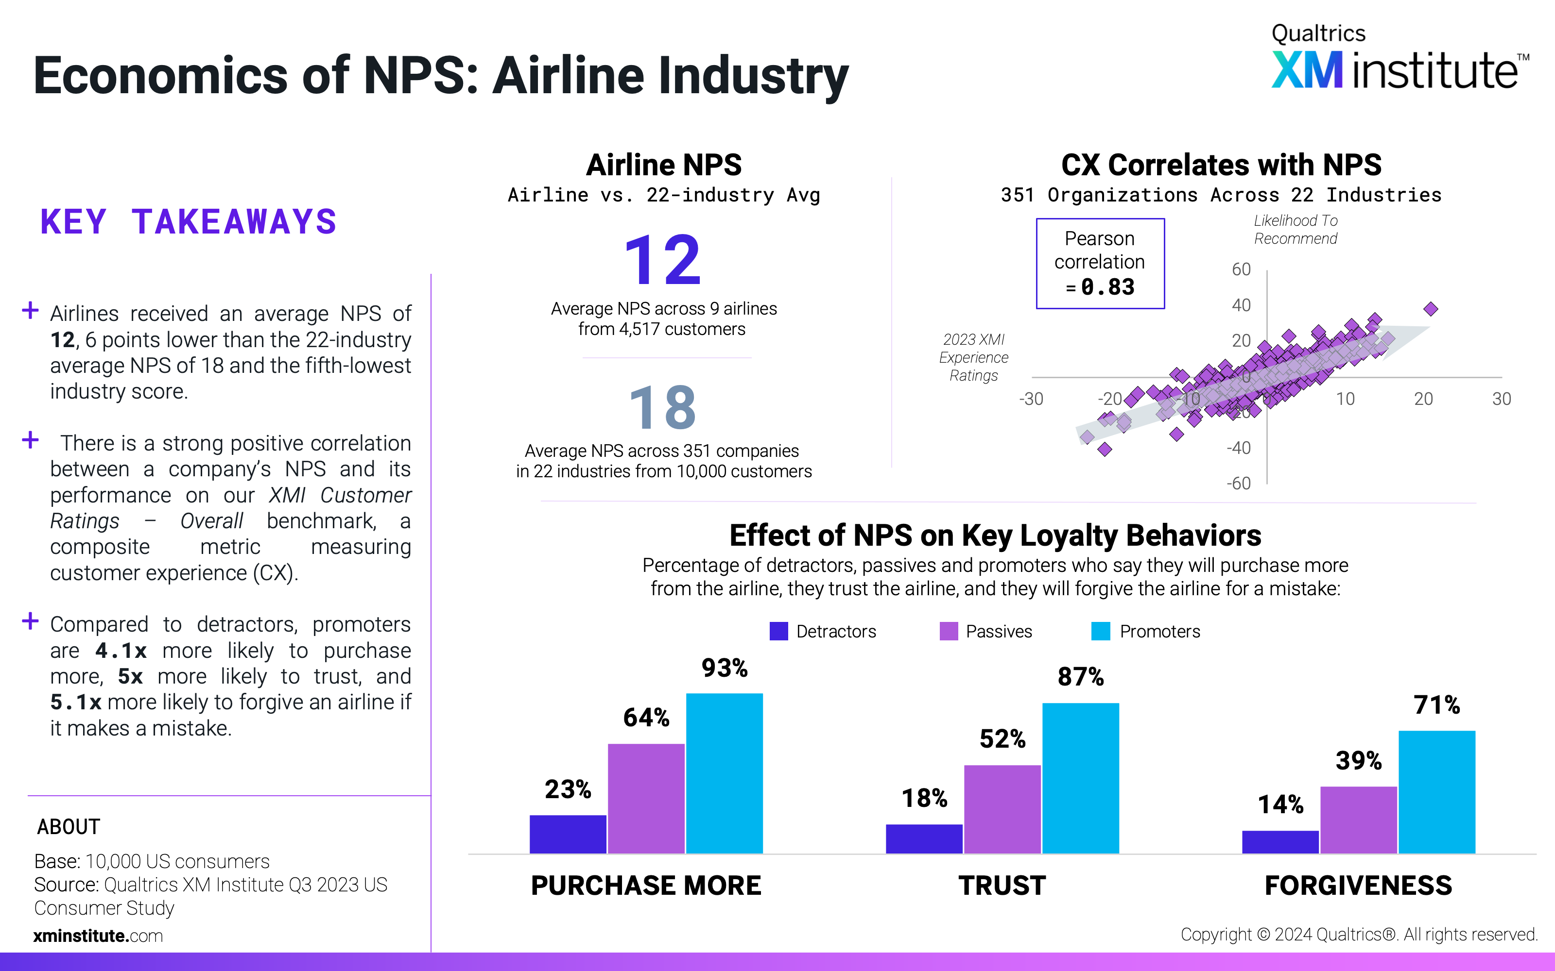

Slide 9
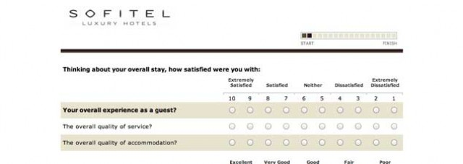
Competitor intelligence
Another important type of applied research
Available through a variety of sources
Benchmarking is a common practice in the industry
Might include guest satisfaction scores (GSS) in hotels
Restaurants also use benchmarking
As do attractions

Slide 10
Benchmarking fast-food restaurants
Figure 6.1 (Source: Adapted from Min and Min, 2010)

Slide 11
The Gaps Model of Service Quality
Figure 6.2 (Source: Parasuraman, et al., 1985)

Slide 12
Measuring service quality
Importance–performance analysis (IPA)
  Relative importance of attributes versus actual performance

Slide 13
Measuring service quality
SERVQUAL
  Difference between expectations and perceptions on a 22 item scale: five dimensions
  Has been adapted to serve different industry sectors

Slide 14
A DINESERV interview
Table 6.3

Slide 15
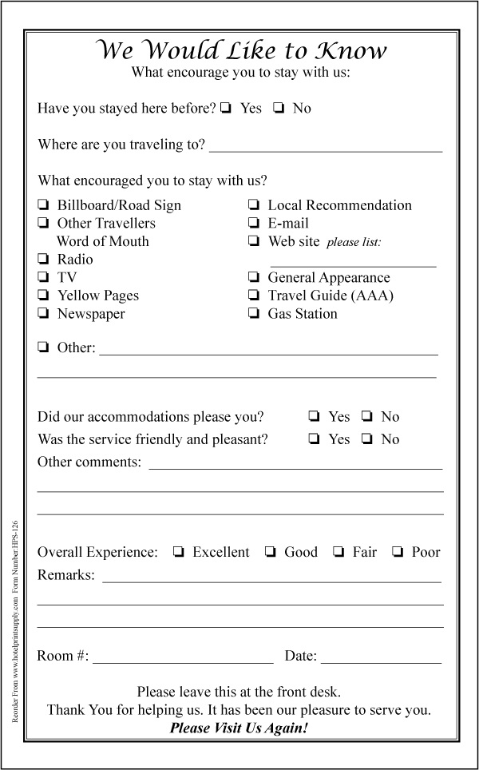
Measuring service quality
  Comment cards
  Performance-based measure and diagnostic tool
  Feedback at time of service experience
  May be more effective than SERVQUAL or IPA
Mystery shopping
  Participant observation
  A common market research technique
  Rich information about service experience as it unfolds

Slide 16
Advantages and disadvantages of mystery shopping
Table 6.4 (Source: Adapted from Hudson, Hudson & Miller, 2004)

Slide 17
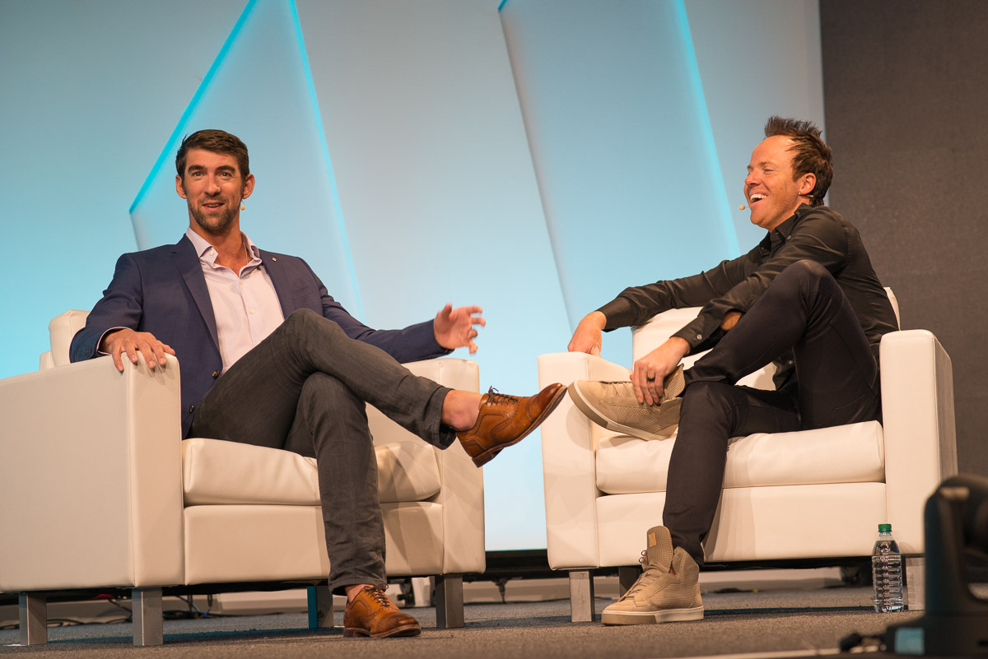
Snapshot: Qualtrics going above and beyond to wow conference delegates
The X4 Summit, put on by Qualtrics, annually attracts more than 10,000 delegates
Customer service is at the core of why the conference is so different from other conferences
Everyone on the team involved in the conference has to go through training, working through a 50-page training manual written especially for the event.
Qualtrics use their experience management platform to measure the success of each event, and get feedback from attendees

Slide 18
Critical incidents studies
Critical incident technique (CIT)
Qualitative interview procedures, verbatim accounts:
  Consumer evaluation of services
  Service failure and recovery
  Employee and customer participation in service delivery
  Service experience
Four main benefits of CIT
  Sound information easily translated into action
  Useful when the service is new, little information exists
  Useful for assessing cross-cultural perceptions

Slide 19
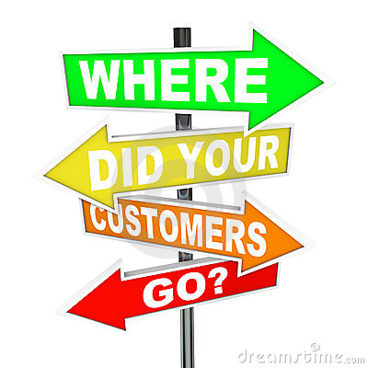
Lost customer research
Few organizations have effective strategies for evaluating customer attrition
Research targets customers who have dropped the company’s service
  Makes inquiries about reasons for leaving
  Identifies failure points and common problems
  Calculates the cost of lost customers
NBRI study – root cause driving down customer loyalty and customer satisfaction (68 %) identified as ‘wait time’
Notes:
S

Slide 20
Online research
Electronic and online surveys
  Computers placed in high-traffic locations
  Customers asked to complete online surveys
  Input tabulated, available instantly
  Can be accessed by corporate and front-line staff
    Instant service recovery
    Long-term service improvement
Virtual focus groups
Online ‘chat’ sessions
  Pre-recruited respondents in guided online discussion
    Time- and cost-saving benefits
Virtual worlds e.g. Second Life
Social media and crowdsourcing e.g. Brand Karma

Slide 21
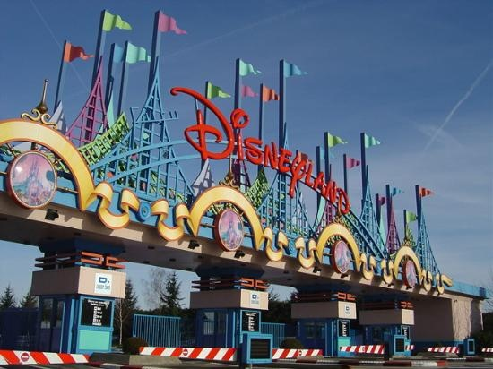
Common research errors
Not enough qualitative information
Improper use of sophisticated statistical analysis
Failure to have a representative sample
Problems with interpretation

Slide 22
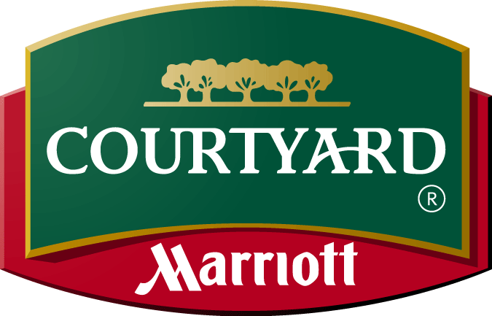
Effective use of market research
Research can play a critical role in development
  Practical decision-making at a strategic level
  Academic understanding of industry development
  Feasibility studies for new projects
Successful research contingent on 3 conditions:
  Sufficient resources allocated to research
  Research results must be believed
  Results should be implemented e.g. Courtyard by Marriott

Slide 23
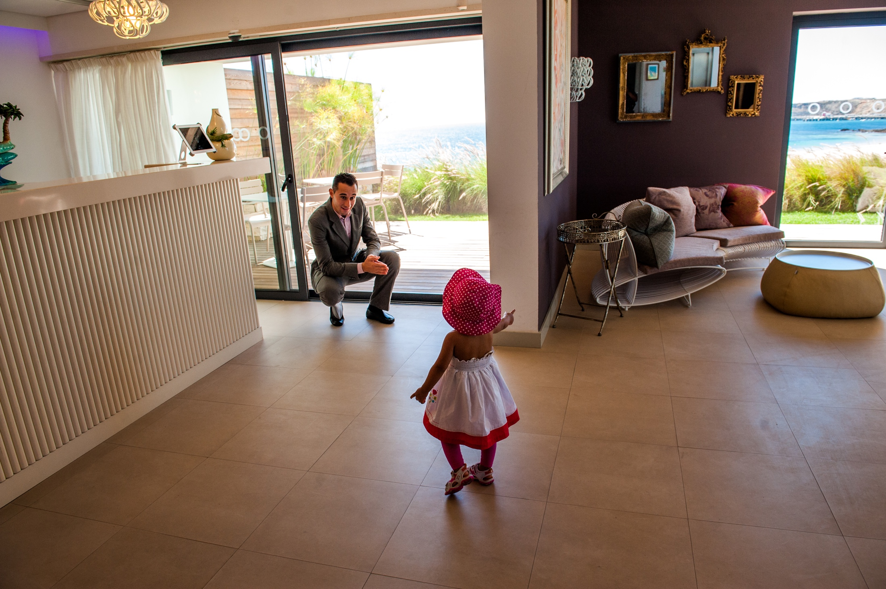
Case Study: Martinhal in Portugal - staying sensitive to the consumer
Dubbed ‘Europe’s Finest Luxury Family Hotels & Resorts’,
Owners developed knowledge of industry through market research, talking to consultants, reading feasibility studies, working with tourism authorities and associations, and looking at other hotels in the area
Over the years they have fine-tuned their marketing increasingly using word-of-mouth via social media platforms to disperse the message.
The marketing team also utilizes billboards (with the current tagline ‘Eat, Stay, Love’), print ads, social media, FAM trips, and direct mail
Owners recently opened an international school in Lisbon

